Slide 1
6
MUHAMAD DANI SETIAWAN
REACT-NATIVE
KAPTEN BINTANG

Slide 2
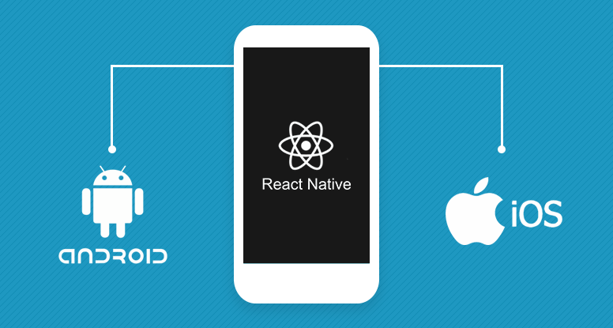
What is React Native?
“Learn once, write everywhere”
Build real mobile apps by using javascript and react (native)

Slide 3
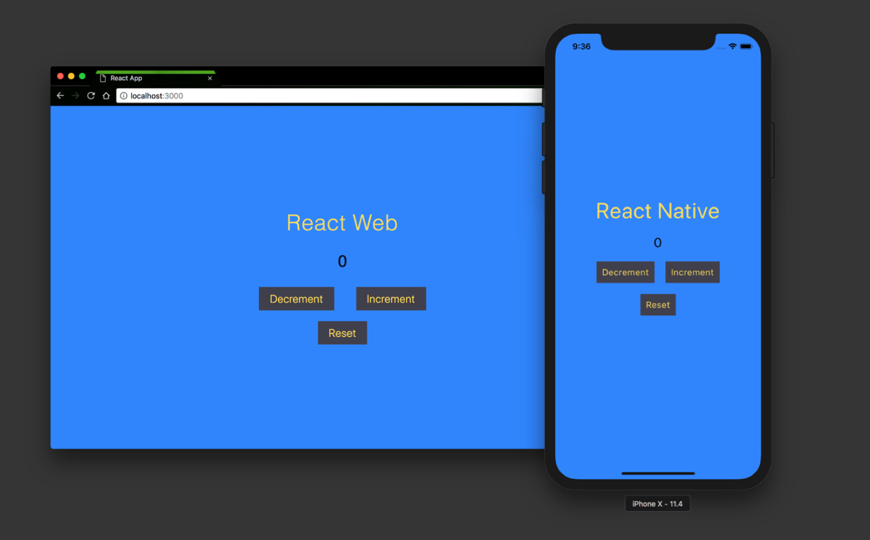
What a react native App is and is not
React.js & React Native

Slide 4
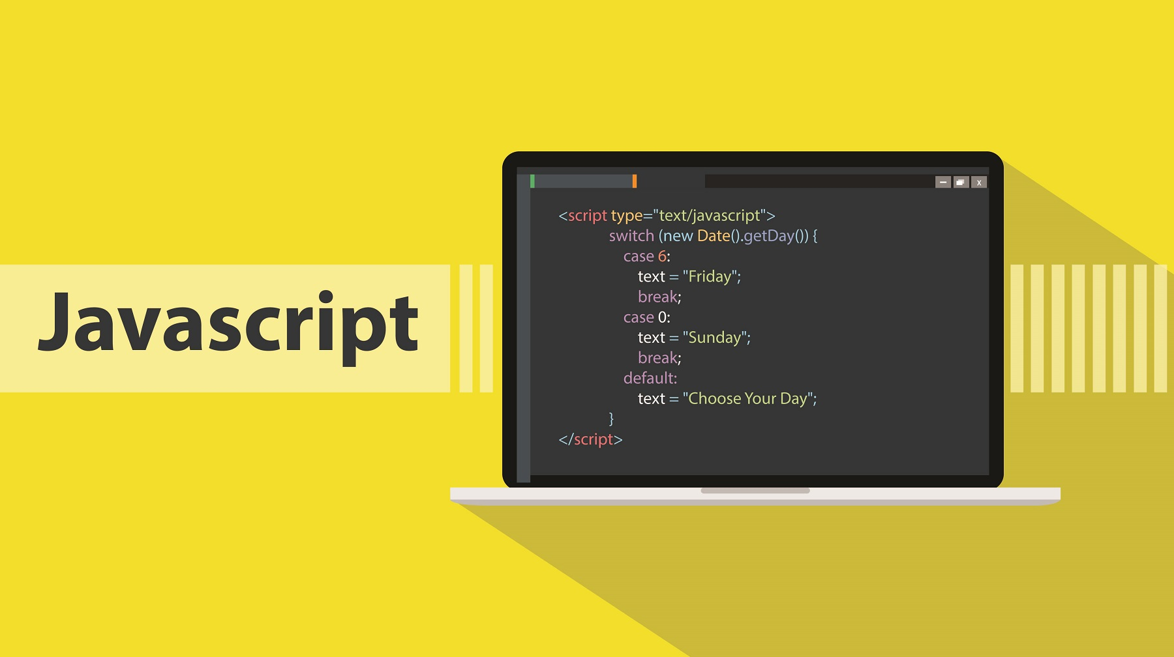
Javascript
Programming language

Slide 5
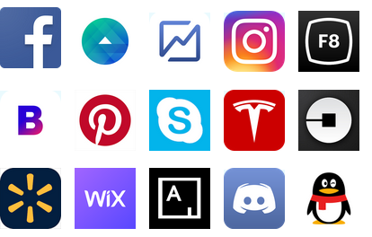
Applications that are made

Slide 6

How Does
It Work

Slide 7
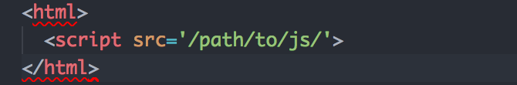
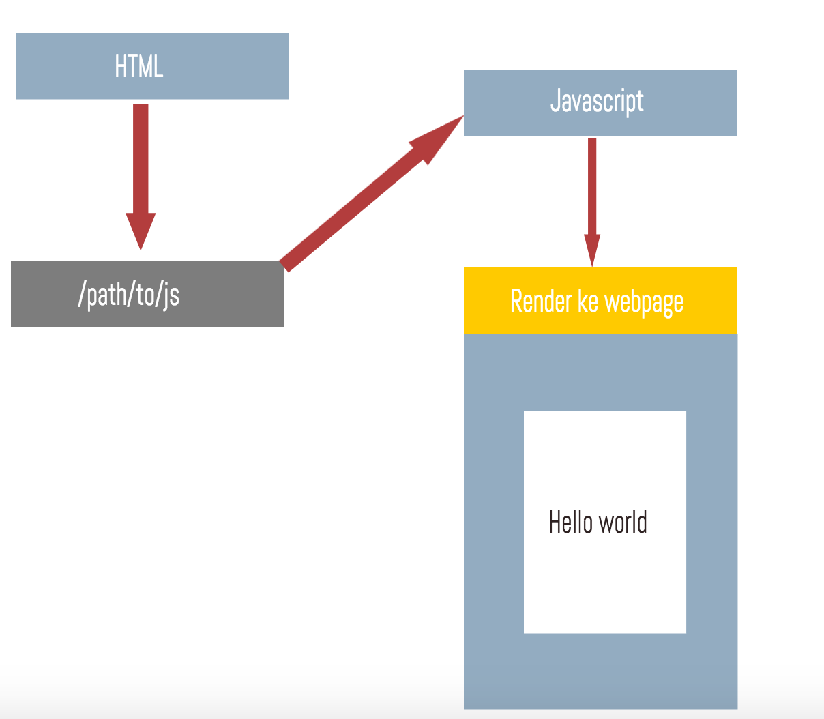

Slide 8
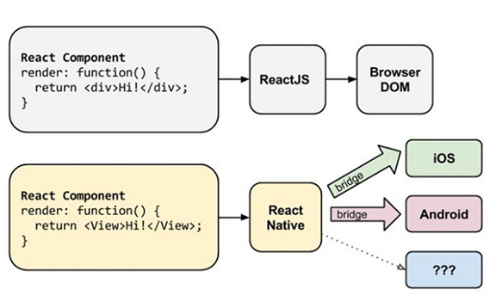

Slide 9
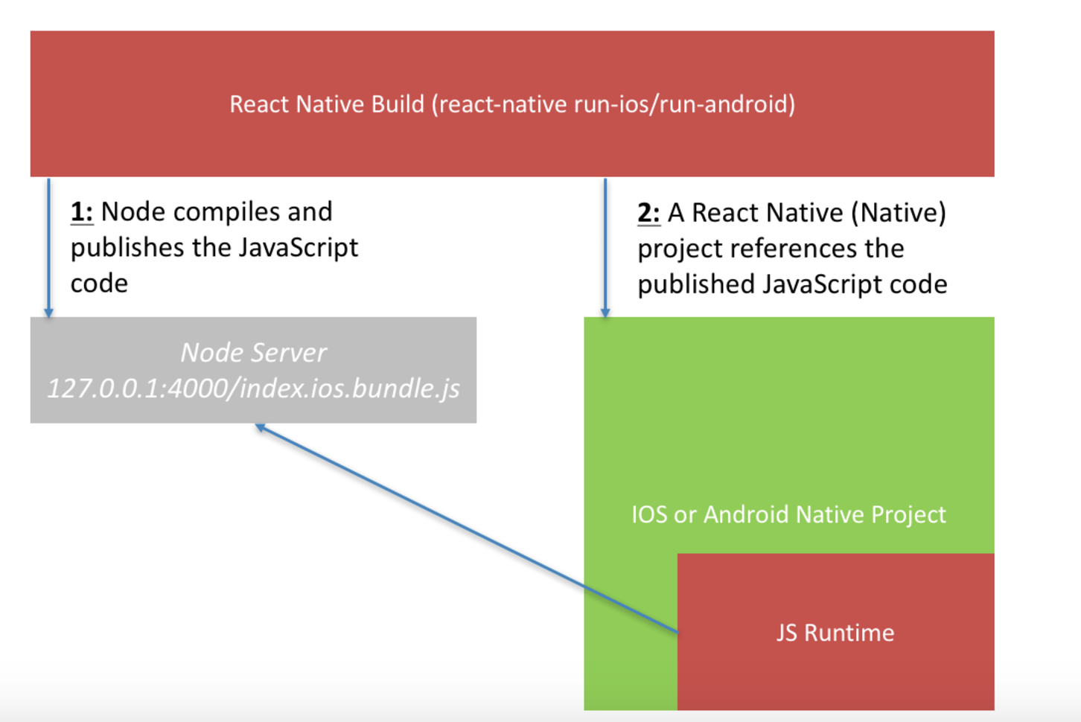
The React Native Build Process Architecture

Slide 10
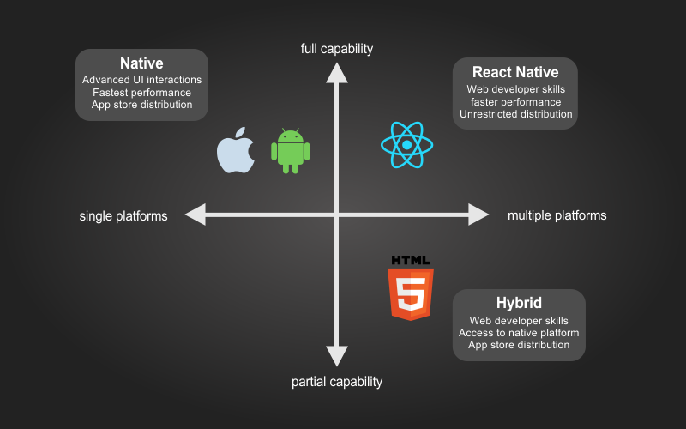
CONCLUSION

